Slide 1
3 facts

Slide 2
The birthday problem

Slide 3
23✕22

Slide 4
23✕22
2

Slide 5
23✕22
2
= 253

Slide 6
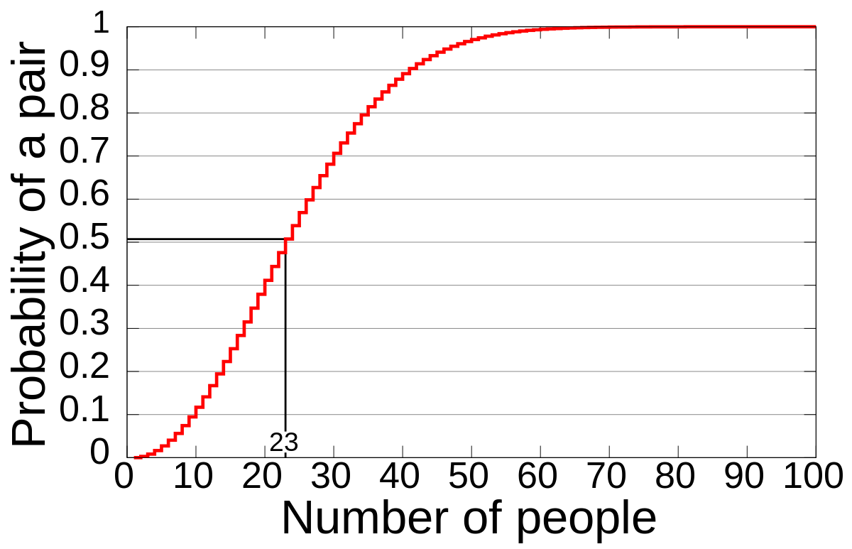

Slide 7
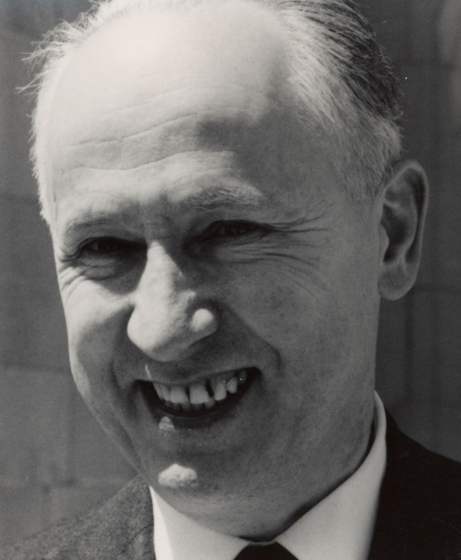
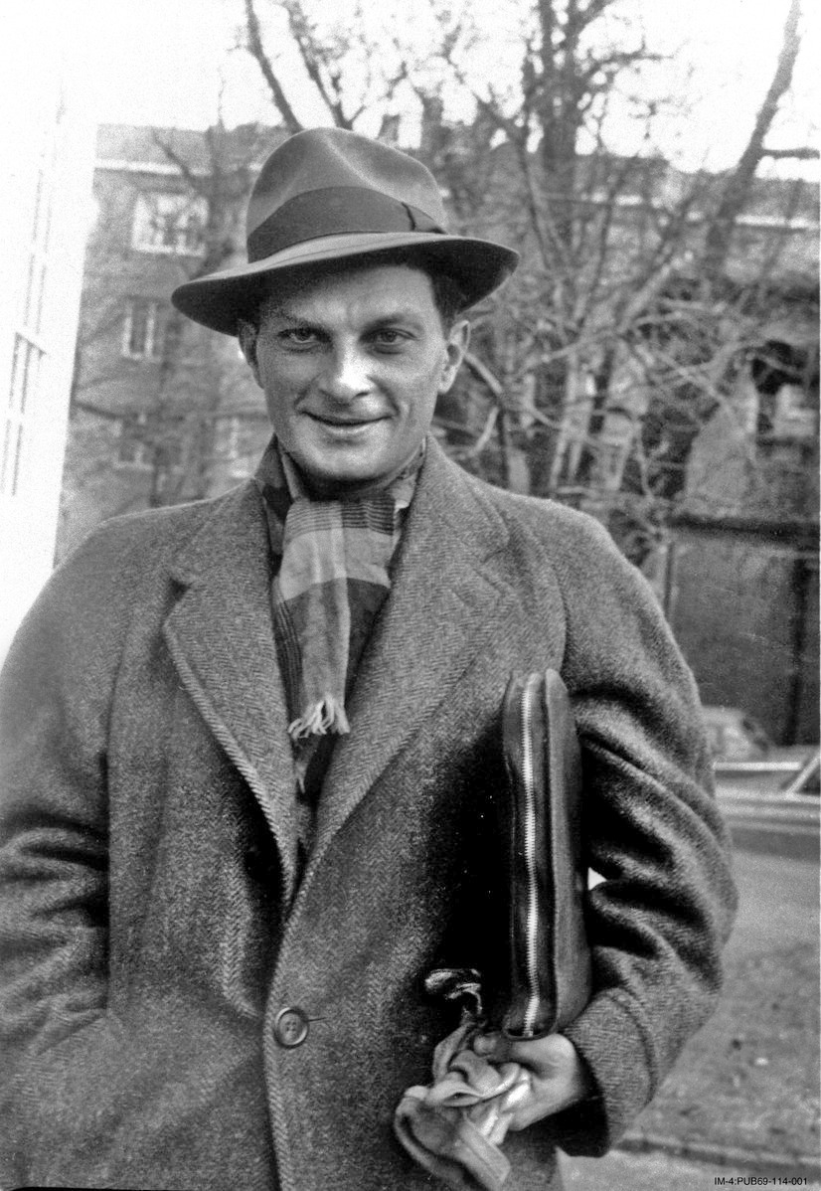
2. Borsuk-Ulam Theorem

Slide 8
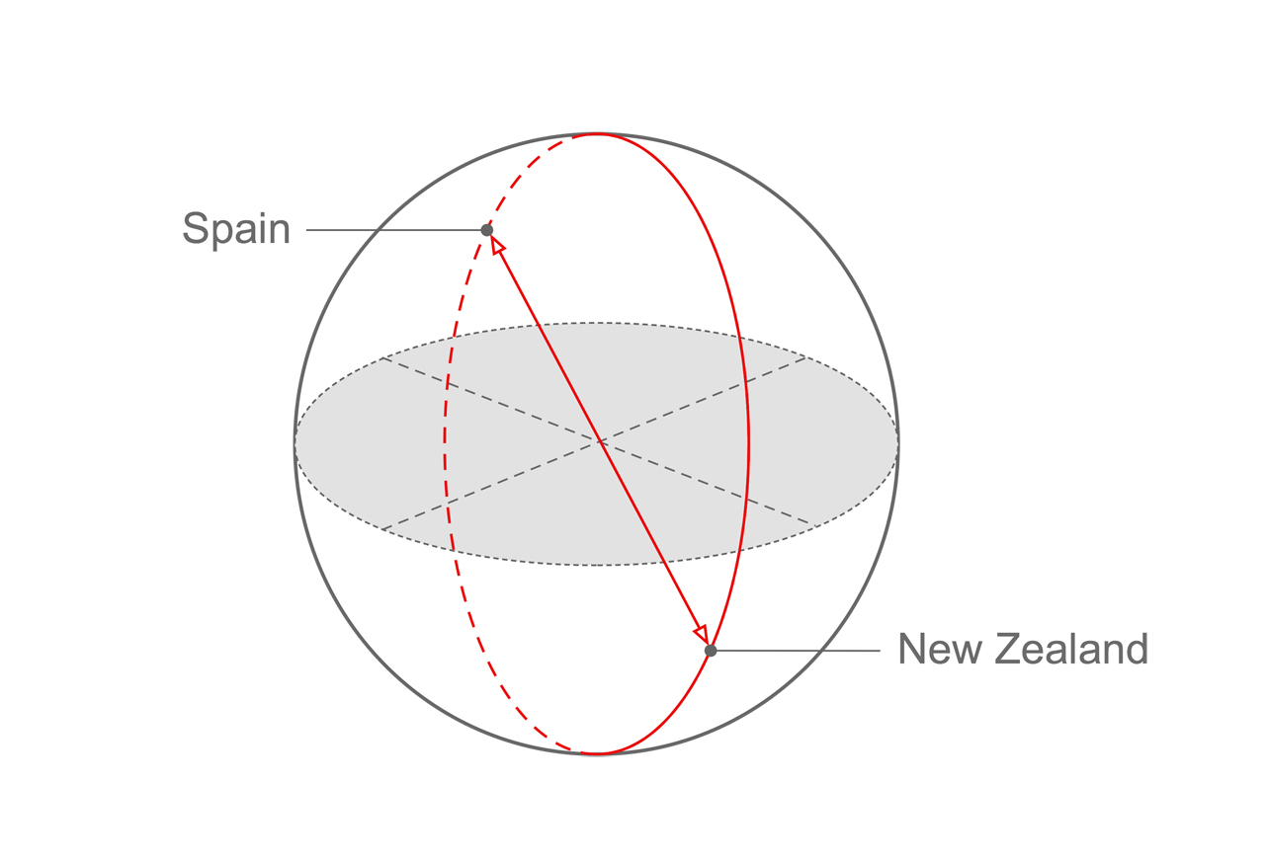
Antipodal points

Slide 9
T: 30 C
P: 100 kPa
T: 30 C
P: 100 kPa

Slide 10
T: 30 C
T: 30 C

Slide 15
3. Monty Hall Problem

Slide 16

1
2
3

Slide 17
1
2

Slide 18
Counterintuitive

Slide 19
Thank you

